Slide 1
CLC – Assignment 1
Ryan Coon & Allen Atkins
CST-201
Prof. Jeremy Wright
November 22, 2021

Slide 2
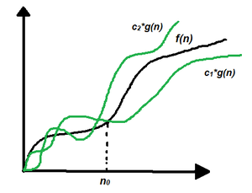
Runtime (Big-Theta) analysis
Big – Theta notations are represented by a Greek letter (Θ).
Big – Theta notation specifies asymptotic bounds (both upper and lower) for a function f(n) and provides the average time complexity of an algorithm.

Slide 3
Runtime (Big-Theta) analysis
Steps to find the average time complexity of any program:
Break the program down into smaller segments.
Find all types and number of inputs and calculate the number of operations they take to be executed. Make sure that the input cases are equally distributed.
Find the sum of all the calculated values and divide the sum by the total number of inputs let say the function of n obtained is g(n) after removing all the constants, then in Θ notation it represented as Θ(g(n))

Slide 4
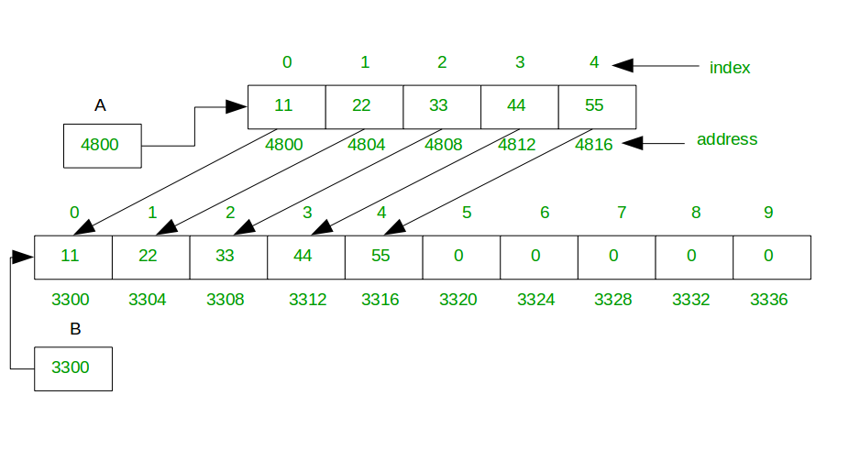
AddElement
Add element at the end if the array size is not enough then extend the size of the array and add an element at the end of the original array as well as given index.
appends take O(n) time only when we insert into a full array. And that is rare, especially if we double the size of the array every time we run out of space.

Slide 5
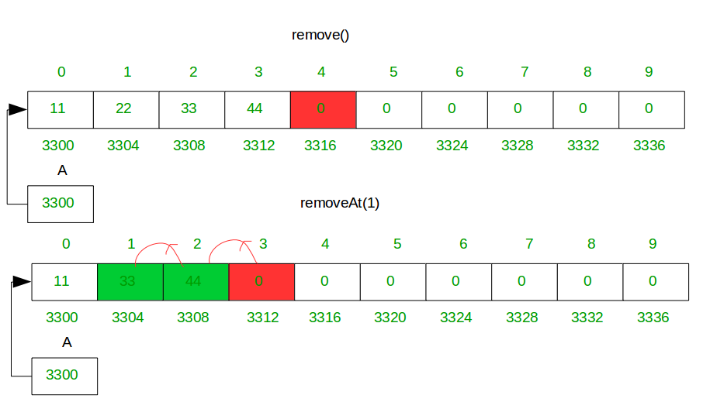
Delete Element
Delete an element from array, default remove() method delete an element from end, simply store zero at last index and you also delete element at specific index by calling removeAt(i) method where i is index. removeAt(i) method shift all right element in the left side from the given index.

Slide 6
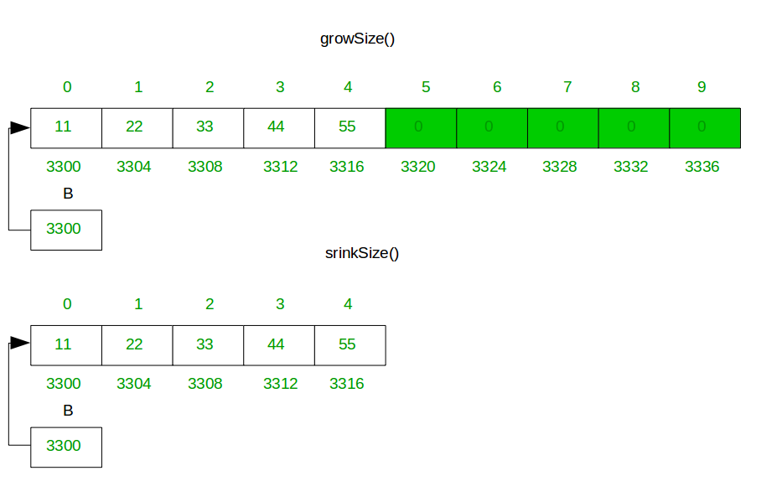
Resize of Array Size
When the array has null/zero data(exclude add by you) at the right side of the array whose take unrequited memory, the method srinkSize() free extra memory.
When all space is consumed, and an additional element is to be added, then the underlying fixed-size array needs to increase size.
resizing is expensive because you must allocate a bigger array and copy over all the elements from the array you have overgrow before we can finally append our item

Slide 7
Array Memory Constraints
Single dimensional array is 12 bytes to accommodate a four-byte array length. A Boolean Array requires 1 byte per element.
Two-Dimensional Array- for a 10x10 array it could be upward of 616 bytes.
Multidimensional array uses the same logic as the two-dimensional array.
The way the Java array is allocated, it will have obvious performance issues. Accessing and assigning the values is quick and easy since it is stored in a block.

